Slide 1
EZDK Agile Development Process
Moataz Sanad

Slide 2
Agenda
Why Agile?
Agile Principles
Agile Roles and Responsibilities
Agile Framework – Scrum
Agile Metrics, Estimations and Capacity
Agile Tools ( Jira Cloud )

Slide 3
Why Agile?
The traditional waterfall model, characterized by sequential and rigid phases, has limitations in addressing the evolving nature of requirements, market dynamics, and customer expectations.
In response to these challenges, EZDK has embraced Agile as a transformative methodology that values individuals, interactions, and the delivery of working software over rigid processes and documentation.

Slide 4
“
Agile Manifesto
1- Individuals and interactions, over processes and tools
2- Working software, over comprehensive documentation
3- Customer collaboration, over contract negotiation
4- Responding to change, over following a plan.
”

Slide 5
Agile Principles
EZDK value both the items on the left (the underline items) as well as the items on the right ( the one’s with no underline ), but EZDK put more weight on the items on the left over the items on the right as this is the core of agile methodology.

Slide 6
Agile Principles
Human Centric approaches
Prioritize Customer Satisfaction
Valuable Software
Welcome Changing Requirements even late in development
to full fill business need
Frequent Delivery of Working Software from 2 weeks to 2 months with preference of shorter periods
Close & Daily [ Mngr & SM ] role.
Build Projects around Motivated Individuals
Collaboration between Stakeholders and Developers
1
2
3
4
5

Slide 7
Agile Principles
Face-to-Face Communication is Key
Even if online
Working Software as the Primary Measure of Progress
Maintain a Sustainable Pace of Work
Simplicity: The Art of Maximizing the Amount of Work Not Done
Continuous Attention to Technical Excellence
6
7
8
9
10

Slide 8
Agile Principles
Self-Organizing Teams
Commitment.
Focus.
Respect.
Adaptability.
Transparency.
Regular Reflection and Adjustment
11
8
12

Slide 9
Time Boxing
Fixed Duration
Regular Iterations
Defined Activities
Time boxing benefits
Increase team productivity as it keeps team focus.
Make the planning process easier as there is kind of rhythm established.
Intervals ensure constant pace avoiding spikes.

Slide 10
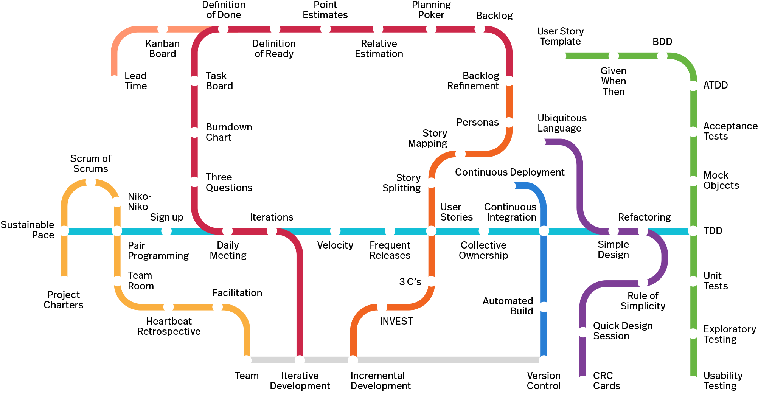
Agile Practices

Slide 11
Agile Roles & Responsibilities
1. Product Owner
2. Scrum Master
3. Development Team
Define and Prioritize the Product Backlog
Represent Customer Needs
Make Decisions
Engage Stakeholders
Facilitate Agile Ceremonies
Remove Impediments
Coash and Mentor
Promote Continuous Improvement
Self Organized
Estimate & Commit
Deliver Incrementally
Cross Functionoally

Slide 12
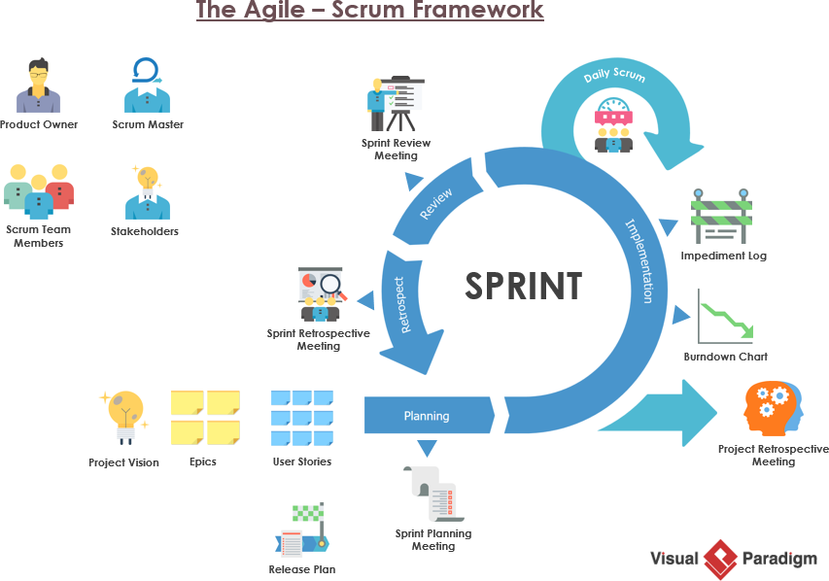

Slide 13
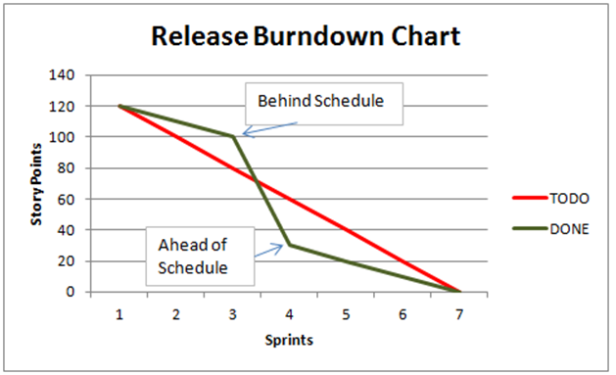
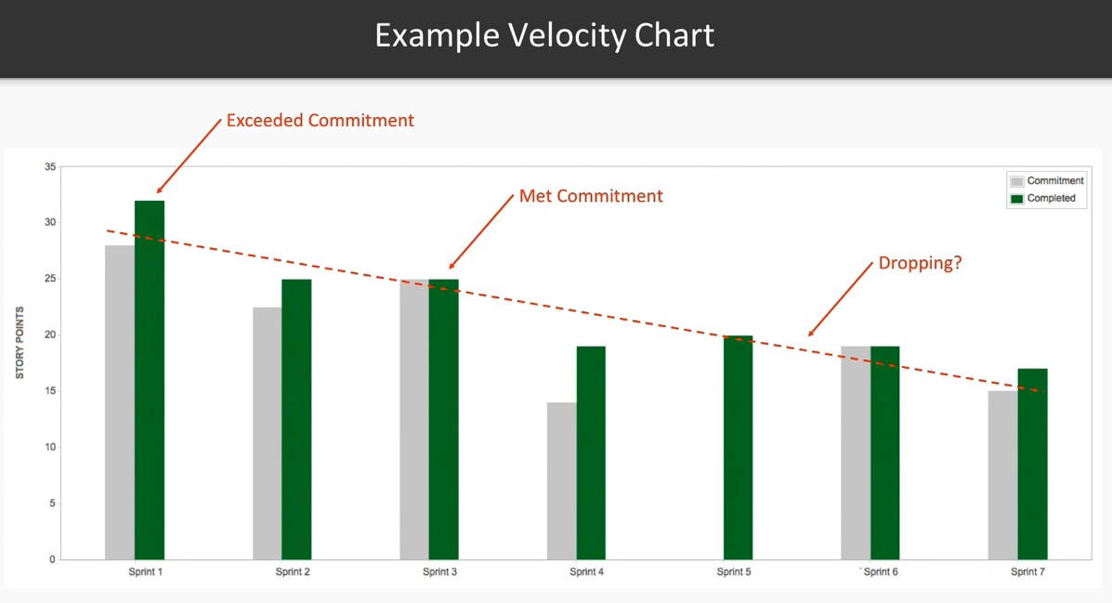
Agile Metrics

Slide 14
Agile Estemation
Relative Sizing
Planning Poker
Capacity Planning
T- Shirt Sizing
(Small, Medium, Large, XL)
Fibonacci
(1,2,3,5,8,13)
Highest Value vs Lowest Value
Availability
Experience
Historical Data

Slide 15
Thank you
JIRA Cloud Demo

